Slide 1

QuickBite Express
Crisis Recovery Analysis
Domain: Food Delivery & Consumer Analytics
Function: Crisis Recovery & Business Strategy
CODEBASICS RESUME PROJECT CHALLENGE #18
PRESENTED BY : RISHITA SINGH

Slide 2
Agenda
Project Context & Crisis Summary
Primary Analysis : Customers, Orders, Delivery, Revenue
Secondary Analysis : Competitor & Market Trends
Key Insights & Recommendations

Slide 3
Project Context & Crisis Summary
Company : QuickBite Express - Bengaluru-based food delivery startup
Crisis Trigger (June 2025) :
  Viral social media post about food safety
  Week-long delivery outage during monsoon
Immediate Impacts :
  Sharp decline in daily orders and customer engagement
  Drop in customer satisfaction scores
  Partner restaurants moved to competitors
  Customer acquisition costs increased

Slide 4
Project Objective
Primary Goal : Provide actionable insights for QuickBite’s crisis recovery
Focus Areas :
  Identify recoverable vs lost customer segments
  Analyze order patterns & delivery performance
  Monitor customer feedback & sentiment
  Evaluate restaurant partnerships for long-term retention
  Recommend targeted campaigns to rebuild trust
Outcome: Support leadership in strategic decision-making

Slide 5
Primary Analysis

Slide 6
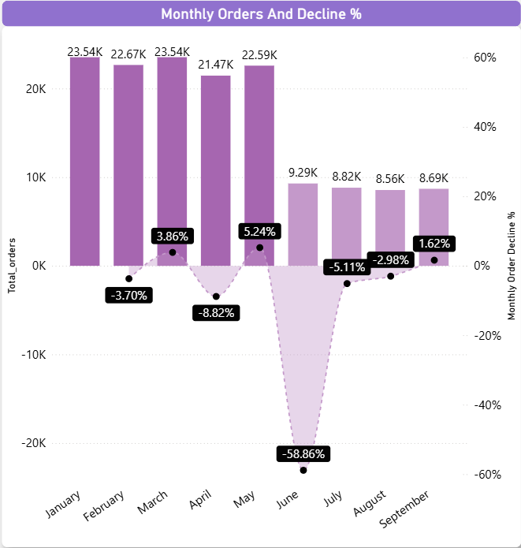
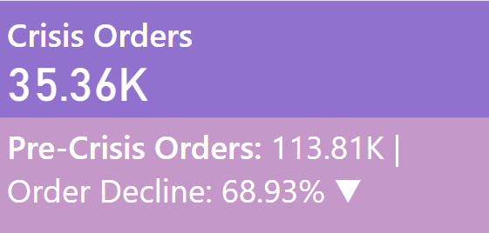
Monthly Orders
Compare total orders across pre-crisis (Jan–May 2025) vs crisis (Jun–Sep 2025). How severe is the decline?
Total Orders :
Pre-Crisis (Jan - May 2025) : 113,810
Crisis (Jun - Sep 2025) : 35,360
Overall Decline: 68.9% Monthly
Trends :
Jan - May: Stable (~21k-23k orders/month)
June: Sharp drop to 9,293 orders (-58.9%)
Jul - Sep: Slight recovery (~8.5k-8.8k orders/month)
Insight: Crisis caused an immediate and severe drop, with partial stabilization in following months.

Slide 7
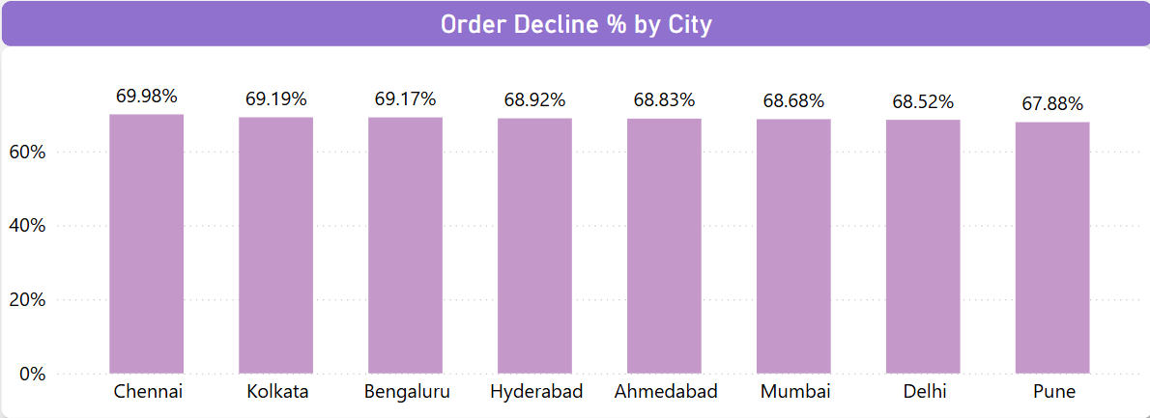
Top 5 Cities - Highest Order Decline
Which top 5 city groups experienced the highest percentage decline in orders during the crisis period compared to the pre-crisis period?
Overall Observation: All major cities experienced a ~68-70% drop in orders during the crisis
Top 5 Cities by % Order Decline: Chennai - 69.98% Kolkata - 69.19% Bengaluru - 69.17% Hyderabad - 68.92% Ahmedabad - 68.83%
Insight: Tier-1 cities were hit hardest, signaling the priority markets for recovery efforts

Slide 8
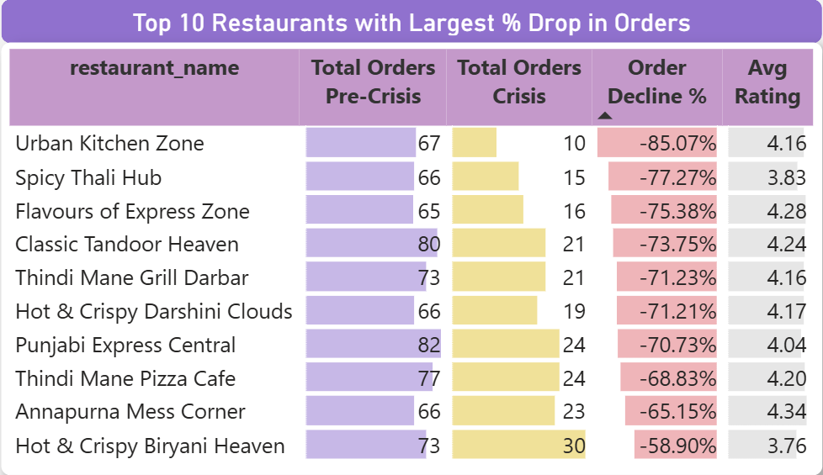
Top 10 Restaurants - Largest Order Decline
Among restaurants with the highest order volumes before the crisis, which top 10 restaurants recorded the largest percentage drop in orders during the crisis?
Top 10 high-volume restaurants faced 71.6% average order decline
Urban Kitchen Zone saw the largest drop at 85%
Restaurants maintained strong average ratings (4.12)
Insight: High-volume restaurants were severely impacted, despite generally good ratings

Slide 9
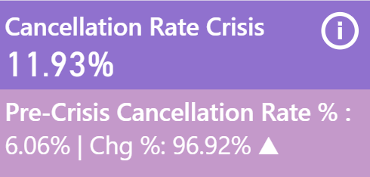
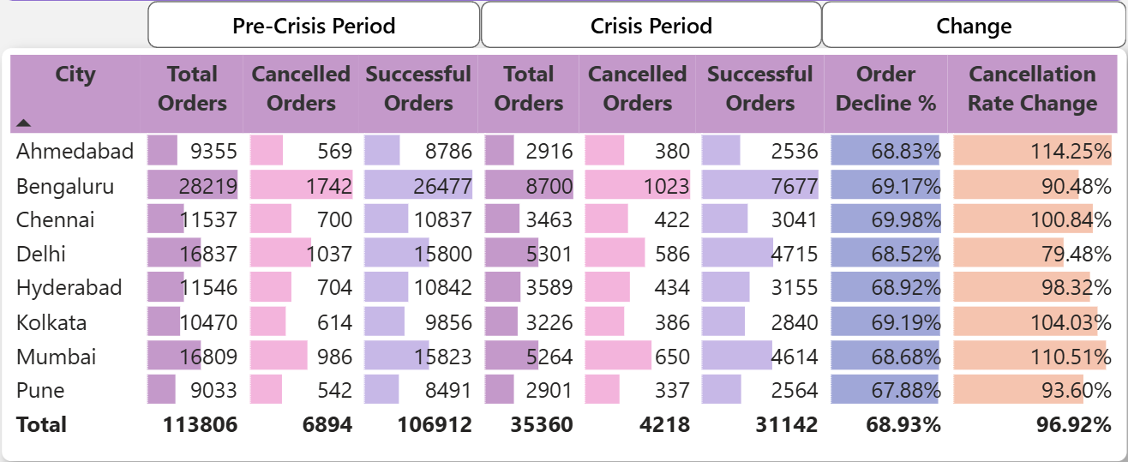
Cancellation Analysis - Pre-Crisis vs Crisis
Cancellation Analysis: What is the cancellation rate trend pre-crisis vs crisis, and which cities are most affected?
Overall cancellation rate nearly doubled during the crisis (Pre-crisis: 6.06% to Crisis: 11.93%)
Highest cancellation rate increases observed in: Ahmedabad: +114% Mumbai: +110% Chennai: +101%
Other Tier-1 cities like Bengaluru, Hyderabad, Kolkata also saw significant increases (≈90–104%)
Indicates major operational disruption during crisis, especially in Tier-1 cities

Slide 10
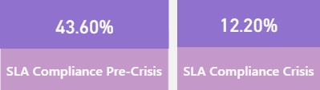
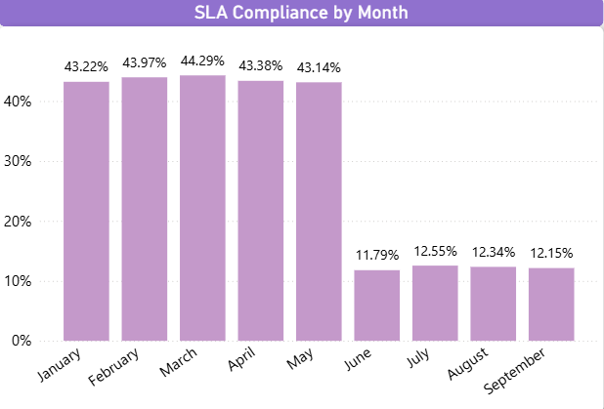

Delivery SLA
Measure average delivery time across phases. Did SLA compliance worsen significantly in the crisis period?
Average delivery time increased during crisis (Pre-crisis: 39.52 mins to Crisis: 60.12 mins)
SLA compliance dropped sharply from 43.6% to 12.2% (-72%)
Month-wise trend: stable ~43% pre-crisis, collapsed to ~12% during crisis (Jun–Sep)
Indicates major operational disruptions, likely contributing to cancellations and reduced customer trust

Slide 11
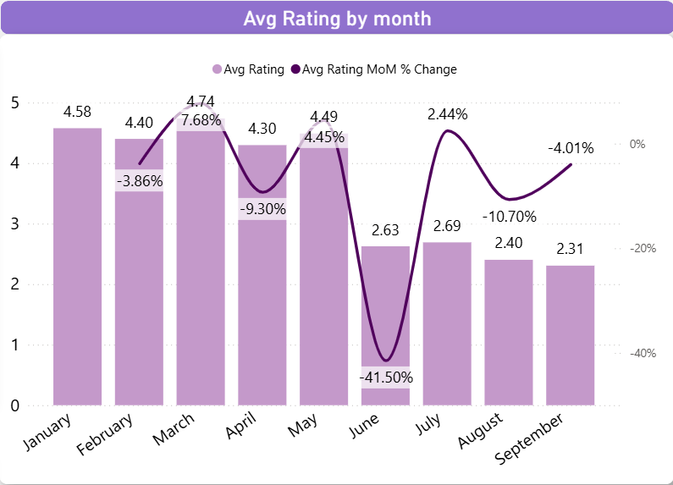
Ratings Fluctuation
Track average customer rating month-by-month. Which months saw the sharpest drop?
Average customer ratings dropped dramatically during the crisis (Pre-crisis: 4.5 to Crisis: 2.51)
June saw the steepest drop, with a 41.5% decline, coinciding with the crisis onset
Ratings remained low through July-September, indicating sustained trust issues
Highlights the need for targeted customer engagement and trust-building initiatives

Slide 12
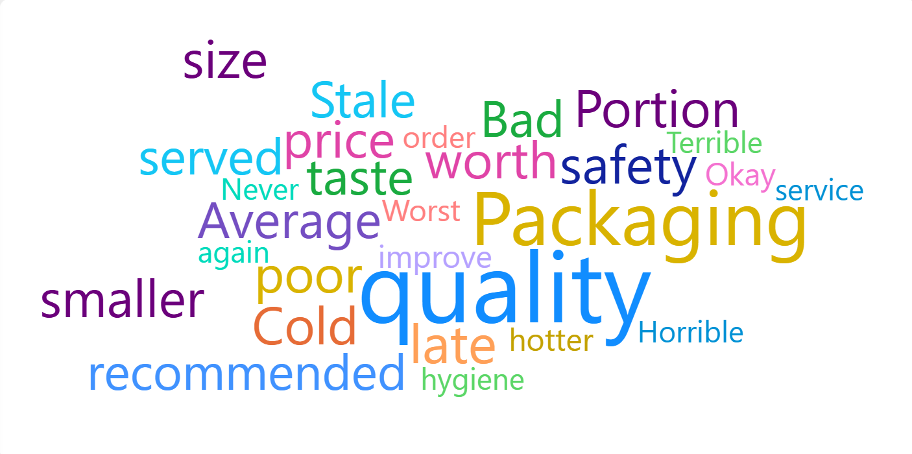
Sentiment Insights
During the crisis period, identify the most frequently occurring negative keywords in customer review texts.
Most frequent negative keywords in customer reviews during the crisis: “Food quality is not good”, “Food safety issue”, “Cold food”
“Portion size smaller than expected”, “Not worth the price”, “Average experience”
“Packaging was poor”, “Packaging issue”, “Food quality not great”
“Bad taste”, “Stale food served”, “Not recommended”
Other recurring complaints: “Very late”, “Worst order”, “Terrible hygiene”, “Horrible service”
Highlights key areas for recovery focus: food quality, safety, packaging, and timely delivery

Slide 13
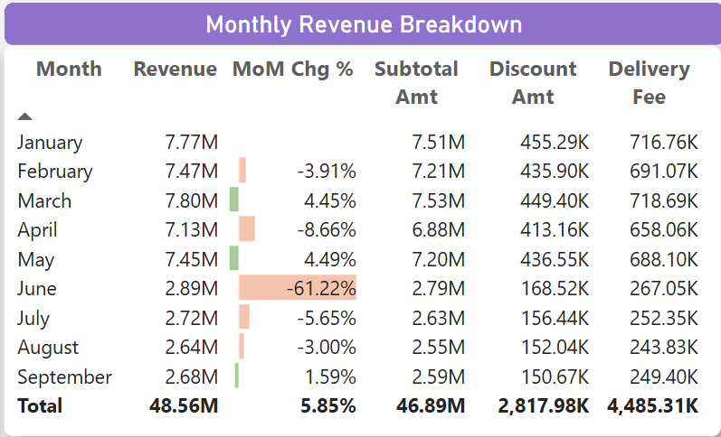
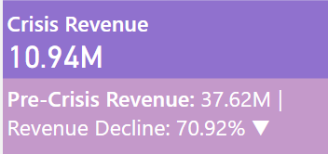
Revenue Impact
Estimate revenue loss from pre-crisis vs crisis (based on subtotal, discount, and delivery fee).
Total revenue dropped dramatically during the crisis, from 37.63M pre-crisis to 10.94M during the crisis
This represents a 70.9% decline, with June seeing the steepest drop
Decline driven by reduced orders, higher cancellations, and operational challenges
Highlights the financial severity of the crisis and the need for urgent recovery measures

Slide 14
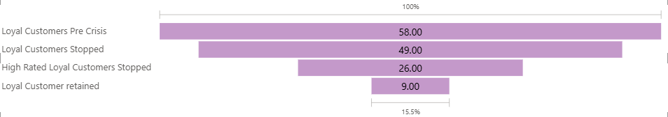
Loyalty Impact
Among customers who placed five or more orders before the
crisis, determine how many stopped ordering during the crisis, and out of those, how many had an average rating above 4.5?
Among customers with 5+ orders pre-crisis, 58 were identified as loyal
49 of these loyal customers stopped ordering during the crisis
26 of the churned loyal customers had an average rating above 4.5, indicating high satisfaction before the crisis
Only 9 loyal customers were retained during the crisis
Highlights the need for targeted re-engagement strategies to recover high-value customers

Slide 15
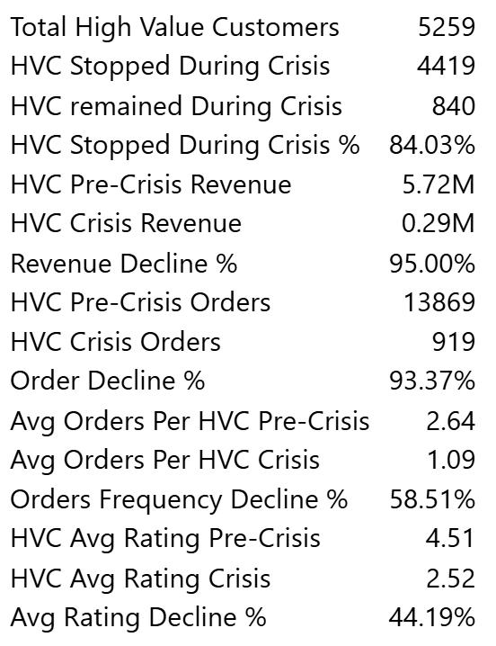
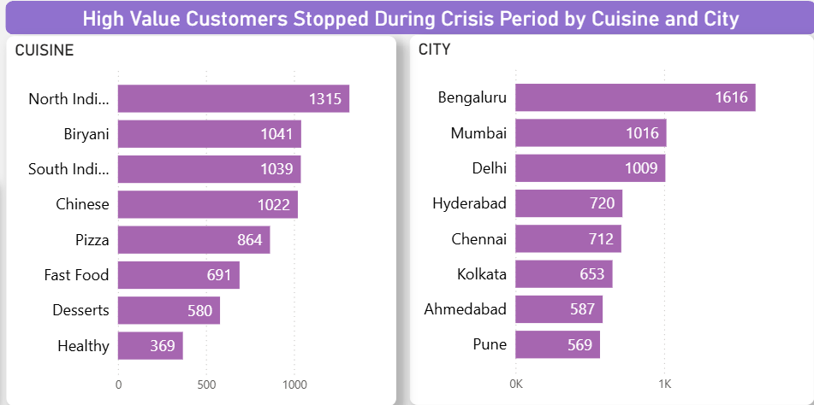
Customer Lifetime Decline
Which high-value customers (top 5% by total spend before the crisis) showed the largest drop in order frequency and ratings during the crisis? What common patterns (e.g., location, cuisine preference, delivery delays) do they share?
High-Value Customers (top 5%): 5,259 identified
84% stopped ordering during the crisis (4,419 customers), while only 840 remained active
Revenue contribution pre-crisis: ~15.2% of total revenue
Revenue impact: Pre-crisis 5.72M to Crisis 0.29M (95% decline)
Order frequency decline: Pre-crisis 13,869 to Crisis 919 (93.4% decline)
Average rating drop: 4.51 to 2.52 (44.2% decline)
Cuisine preference most affected: North Indian, Biryani, South Indian, Chinese, Pizza
Cities most affected: Bengaluru, Mumbai, Delhi, Hyderabad, Chennai
Highlights critical loss of top customers, requiring targeted recovery campaigns

Slide 16
Secondary Analysis

Slide 17
Competitive Benchmarking - Crisis Impact
How does QuickBite’s crisis impact compare to competitor trends (Swiggy, Zomato) during the same period?
QuickBite experienced a steeper decline in orders (~69%) during the crisis compared to typical industry trends.
Publicly known competitors (Swiggy, Zomato) generally face moderate monsoon or operational declines (~20–30%).
QuickBite’s sharp drop was primarily driven by food safety incidents and delivery outages.
Indicates the crisis was predominantly QuickBite-specific, not purely industry-wide.
Recovery strategies should focus on rebuilding trust, improving operational reliability, and competitive positioning.

Slide 18
Customer Acquisition Cost (CAC) - Contributing Factors
What external factors (e.g., ad prices, seasonal effects) may
have contributed to CAC tripling?
Customer acquisition cost tripled during the crisis, indicating higher effort to attract and retain customers.
Key contributing factors:
Rising digital ad prices increasing marketing spend.
Seasonal delivery challenges affecting conversions during monsoon.
Increased customer incentives like discounts and cashback to encourage orders.
Emphasizes the need for efficient, targeted marketing campaigns to
optimize spend and recover the customer base.

Slide 19
Trust Rebuilding Strategies
Which strategies (cashbacks, partnerships, food safety audits) could be most effective to rebuild trust?
Enhanced food safety protocols and regular audits to ensure quality and hygiene.
Targeted cashback and discount campaigns to re-engage lapsed and high-value customers.
Strategic restaurant partnerships to expand variety and strengthen reliable service.
Transparent communication with customers about safety measures and service improvements.
Focus on combined approach: operational excellence + customer incentives + reliable partnerships.

Slide 20
Restaurant Churn Risk
Which types of restaurants (cloud kitchens vs dine-in, small vs large brands) are most likely to churn?
Cloud kitchens and small independent brands are more likely to churn during a crisis.
Large, established dine-in restaurants tend to stay due to brand strength and stable customer base.
Churn risk is higher for restaurants facing:
Operational challenges
Delivery delays
Lower order volumes
Recovery focus should target high-risk restaurants to maintain
platform variety and customer satisfaction.

Slide 21
Lapsed Customer Recovery Potential
Which lapsed customers (churned post-crisis) show the highest probability of returning with the right incentives?
High-value lapsed customers show the highest probability of returning with targeted incentives.
Customers with previous order frequency ≥5 or average ratings ≥4.5 are more likely to re-engage.
Effective incentives include:
Personalized cashback or discount offers
Exclusive loyalty rewards
Targeted communication highlighting service improvements
Recovery focus on these segments can maximize revenue impact
and rebuild engagement efficiently.

Slide 22
Summary & Recommendations

Slide 23
Key Findings
Overall orders declined ~69% during the crisis; customer satisfaction dropped from 4.5 to 2.51.
Tier-1 cities like Chennai, Kolkata, Bengaluru, Hyderabad, and Ahmedabad experienced the highest order declines.
Top high-volume restaurants and high-value customers were significantly impacted.
Cancellation rates and SLA compliance worsened drastically.
Negative reviews highlighted food quality, safety, and delivery delays.

Slide 24
Recommendations:
Customer Recovery: Target high-value and loyal lapsed customers with personalized offers and communication.
Operational Excellence: Strengthen delivery SLA compliance, reduce cancellations, and ensure food safety audits.
Restaurant Partnerships: Focus on retaining high-risk cloud kitchens and small brands while maintaining variety.
Trust & Engagement: Transparent communication, enhanced safety measures, and promotional campaigns to rebuild confidence.
Marketing Efficiency: Optimize CAC by running targeted campaigns, prioritizing segments with high recovery potential.

Slide 25
THANK YOU

